Slide 1
Iterators
Dr. Maher Mneimneh

Slide 2
Iterators
An iterator
An object that enables you to traverse entries in a collection
During an iteration, each item is visited once
We control the progress of the iterator by repeatedly asking the iterator to give us a refence to the next entry in the collection
Allows looking at the data, and modifying data (by adding and removing)
Loops are an example of iteration
E.g, nameList is a array list of strings
int listSize = nameList.getLength();
for(int position = 1; position <= listSize; position++)
System.out.println(nameList.getEntry(position);
Instead of displaying the entries, we can perform other operations

Slide 3
Iterators
What if nameList is a linked list?
int listSize = nameList.getLength();
for(int position = 1; position <= listSize; position++)
System.out.println(nameList.getEntry(position);
The complexity of above operation is O(n²)
Why don’t we add a method displayList() to array/linked list?
We might want to perform another operation on every element
We will need to add a new method for each such operation
The class designer will not know all the different things a client will like to do with data
We need a way for the client to efficiently step through the data to retrieve or modify the entries

Slide 4
The Interface Iterator
package java.util;
public interface Iterator < T >
{
/** Detects whether this iterator has completed its traversal
and gone beyond the last entry in the collection of data.
@return true if the iterator has another entry to return */
public boolean hasNext ();
/** Retrieves the next entry in the collection and
advances this iterator by one position.
@return a reference to the next entry in the iteration,
if one exists
@throws NoSuchElementException if the iterator had reached the
end already, that is, if hasNext() is false */
public T next ();
/** Removes from the collection of data the last entry that
next() returned. A subsequent call to next() will behave
as it would have before the removal.
Precondition: next() has been called, and remove() has not been
called since then. The collection has not been altered
during the iteration except by calls to this method.
@throws IllegalStateException if next() has not been called, or
if remove() was called already after the last call to
next().
@throws UnsupportedOperationException if the iterator does
not permit a remove operation. */
public void remove (); // Optional method
}

Slide 5
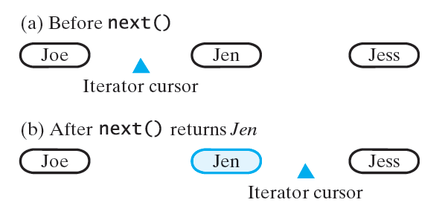
The Interface Iterator
How iterator works?
Marks its position by pointing to a location in a collection
First position: before first entry
At end: after last entry
hasNext: sees whether a next entry exists and returns true or false accordingly
When hasNext() returns true:
next() moves iterator over next entry and returns a reference to it
else, next() throws NoSuchElementException if no more elements
remove() removes the entry that next just returned
remove is optional
Can implement it to throw UnsupportedOperationException

Slide 6
The Interface Iterable
Iterable declares one method, iterator, which returns an iterator that adheres to the interface Iterator
public interface Iterable< T > {
/** return an iterator for a collection of objects of type T*/
Iterator<T> iterator();
}
A collection that implements Iterable can return an iterator that you can use
Example: Suppose ListInterface extends the interface Iterable and AList implements ListInterface
ListInterface<String> nameList = new AList<>();
nameList.add(“Jamie”);
nameList.add(“Joey”);
nameList.add(“Rachel”);
Iterator<String> nameIterator = nameList.iterator();
while (nameIterator.hasNext())
System.out.println(nameIterator.next());

Slide 7
The Interface Iterable
We can remove the entry that was returned by last call to next(). Example: Suppose ListInterface extends the interface Iterable and AList implements ListInterface
ListInterface<String> nameList = new AList<>();
nameList.add(“Jamie”);
nameList.add(“Joey”);
nameList.add(“Rachel”);
Iterator<String> nameIterator = nameList.iterator();
String name1 = nameIterator.next(); // returns the string Jamie
String name2 = nameIterator.next(); // returns the string Joey
nameIterator.remove(); // removes Joey from the list
nameIterator.next(); // returns the string Rachel
Calling remove() before next() result in an IllegalStateException
ListInterface<String> nameList = new Alist<>();
nameList.add(“Jamie”);
nameList.add(“Joey”);
nameList.add(“Rachel”);
Iterator<String> nameIterator = nameList.iterator();
nameIterator.remove(); //throws IllegalStateException
nameIterator.next();
nameIterator.remove(); //ok
nameIterator.remove(); // throws IllegalStateException

Slide 8
Multiple Iterators
We can write code with two iterators
Example iterator that counts occurrence of each name
ListInterface<String> nameList = new Alist<>();
nameList.add(“Brad”); nameList.add(“Jane”);
nameList.add(“Bob”); nameList.add(“Jane”);
nameList.add(“Bette”); nameList.add(“Brad”);
nameList.add(“Jane”); nameList.add(“Brenda”);
Iterator<String> nameIterator = nameList.iterator();
while(nameIterator.hasNext()) {
String currentName = nameIterator.next();
int nameCount = 0;
Iterator<String> countingIterator = namelist.iterator();
while(countingIterator.hasNext()) {
String nextName = countIterator.next();
if(currentName.equals(nextName))
nameCount++;
}
System.out.println(currentName + “ occurs “ + nameCount + “times.”);
}
To remove duplicates change if to
if(currentName.equals(nextName)) {
nameCount++;
if (nameCount > 1) countingIterator.remove();
}

Slide 9
Iterable and for-each loops
A class that implements Iterable can be used in a for-each loop to traverse its elements
ListInterface<String> nameList = new Alist<>();
nameList.add(“Jamie”);
nameList.add(“Joey”);
nameList.add(“Rachel”);
for(String name : nameList)
System.out.print(name + “ “);
System.out.println();

Slide 10
Ways to Implement an Iterator
Possible way to provide an ADT with traversal operations
Define them as ADT operations
ListInterface extends Iterator
Better way
Implement the iterator methods within their own class
class can be public and separate from the class that implements ADT – approach called separate class iterator
Iterator class can be a private inner class of the class that implements the ADT – approach called inner class iterator
Inner class iterator is usually preferable

Slide 11
Separate Class Iterator
nameList is an instance of AList or LList
SeparateIterator s a public class that implements java.Util.Iterator interface
We can create an iterator for nameList as follows
ListInterface<String> nameList = new AList<>();
Iterator<String> nameIterator = new SeparateIterator<>(nameList);
class SeparateIterator
public class SeparateIterator<T> implements Iterator<T> {
private ListInterface<T> list;
private int nextPosition; // Position of entry last returned by next()
private boolean wasNextCalled; // Needed by remove
public SeparateIterator(ListInterface<T> aList) {
list = aList;
nextPosition = 0;
wasNextCalled = false;
}
…
}

Slide 12
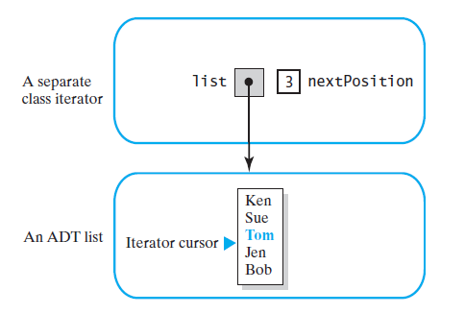
Separate Class Iterator
hasNext
public boolean hasNext() {
return nextPosition < list.getLength();
}
next
public T next() {
if (hasNext()) {
wasNextCalled = true;
nextPosition++;
return list.getEntry(nextPosition);
}
else
throw new NoSuchElementException("Illegal call to next(); " +
"iterator is after end of list.");
}
What is the complexity of next for AList and LList?

Slide 13
Separate Class Iterator
remove
public void remove() {
if (wasNextCalled)
{
// nextPosition was incremented by the call to next(), so
// it is the position number of the entry to be removed
list.remove(nextPosition);
nextPosition--; // A subsequent call to next() must be
// unaffected by this removal
wasNextCalled = false; // Reset flag
}
else
throw new IllegalStateException("Illegal call to remove(); " +
"next() was not called.");
}

Slide 14
Separate Class Iterator
Separate class iterator must access the public methods of an ADT
For stacks, no sufficient public access is provided to implement an iterator
Because of indirect access to data members, a separate class iterator takes longer to execute (e.g, next() for LList)

Slide 15
Inner Class Iterator
Define iterator class as an inner class of ADT
Since iterator belongs to an inner class, it has access to data fields
If ADT implements Iterable, it can be used in a for-each loop
Inner class implementations are usually preferable
Implement Iterator for LList (no remove), and AList

Slide 16
Linked Implementation
ListWithIteratorInterface
Book provides additional method getIterator() that calls iterator() – it is not needed
public interface ListWithIteratorInterface<T> extends ListInterface<T>, Iterable<T>
{
public Iterator<T> getIterator();
}
class LinkedListWithIterator
public class LinkedListWithIterator<T> implements ListWithIteratorInterface<T>
{
private Node firstNode;
private int numberOfEntries;;
public Iterator<T> iterator() {
return new IteratorForLinkedList();
}
public Iterator<T> getIterator() {
return iterator();
}
private class IteratorForLinkedList implements Iterator<T> {
…
}
…
}

Slide 17
Linked Implementation
class IteratorForLinkedList
private class IteratorForLinkedList implements Iterator<T> {
private Node nextNode; // Node containing next entry in iteration
private IteratorForLinkedList() {
nextNode = firstNode;
}
public boolean hasNext() {
return nextNode != null;
}
public T next() {
if (hasNext()) {
Node returnNode = nextNode; // Get next node
nextNode = nextNode.getNextNode(); // Advance iterator
return returnNode.getData(); // Return next entry
}
else
throw new NoSuchElementException("Illegal call to next(); " +
"iterator is after end of list.");
}
public void remove() {
throw new UnsupportedOperationException("remove() is not " +
"supported by this iterator");
}
}

Slide 18
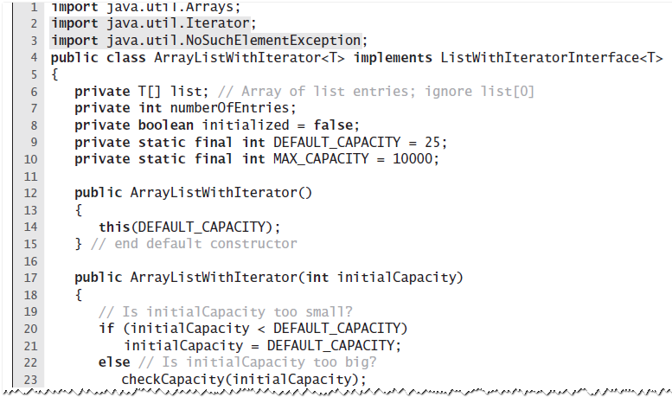
Array-Based Implementation
class ArrayListWithIterator

Slide 19
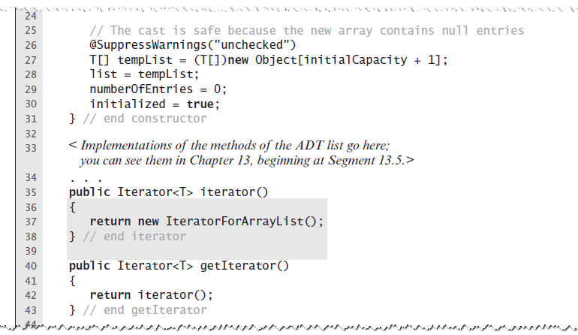
Array-Based Implementation
class ArrayListWithIterator

Slide 20
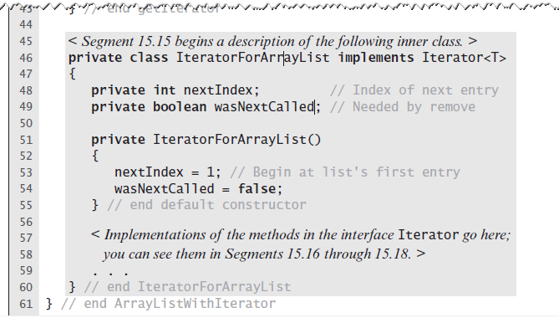
Array-Based Implementation
class ArrayListWithIterator
Note: Assume for this chapter that ArrayList has first element at
index 1 in array and NOT 0

Slide 21
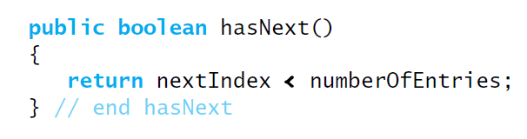
Array-Based Implementation
Method hasNext
=

Slide 22
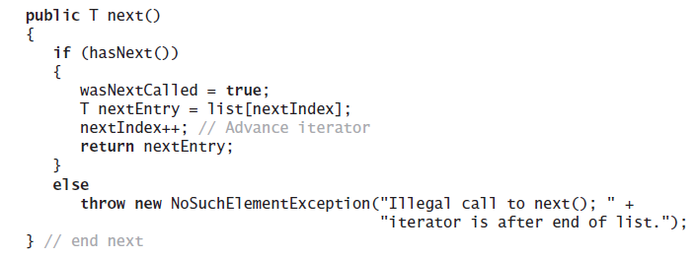
Array-Based Implementation
Method next

Slide 23
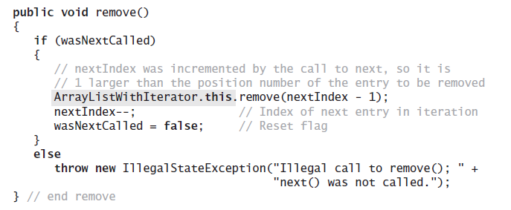
Array-Based Implementation
The method remove.

Slide 24
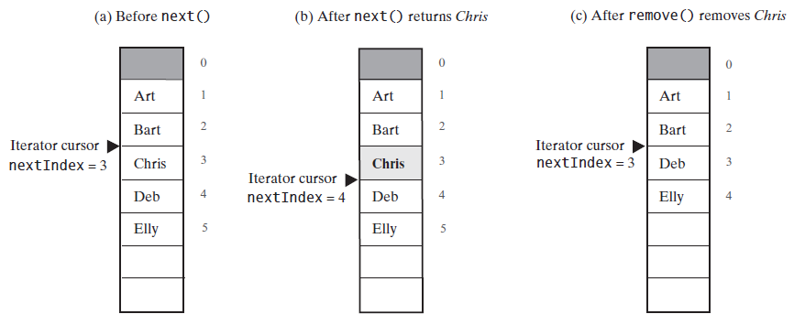
Array-Based Implementation
FIGURE 15-4 The array of list entries and nextIndex (a) just before the call to next; (b) just after the call to next but before the call to remove; (c) after the call to remove

Slide 25
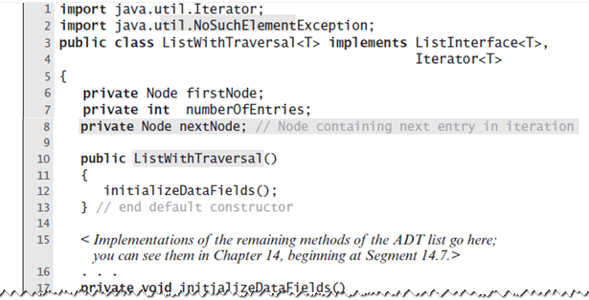
Why Are Iterator Methods in Their Own Class?
Why we didn’t consider the iterator operations as additional operations in class AList or LList?
Modify the linked implementation by adding the methods in the Java interface Iterator
class ListWithTraversal

Slide 26
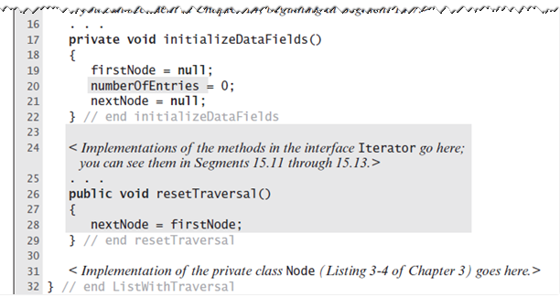
Why Are Iterator Methods in Their Own Class?
class ListWithTraversal

Slide 27
Why Are Iterator Methods in Their Own Class?
These traversal methods can execute quickly
They have direct access to the underlying data structure
Disadvantages
Only one traversal at a time
Operation such as resetTraversal necessary – “interface bloat”
Mixing the functionality of a list with an iterator is poor design
Inner class implementation has the same advantages with none of the disadvantages

Slide 28
The Interface ListIterator
public interface ListIterator<E> extends Iterator<E> {
/**
* Returns true if this list iterator has more elements when
* traversing the list in the forward direction. (In other words,
* returns true if next() would return an element rather
* than throwing an exception.)
*
* @return true if the list iterator has more elements when
* traversing the list in the forward direction
*/
boolean hasNext();
/**
* Returns the next element in the list and advances the cursor position.
* This method may be called repeatedly to iterate through the list,
* or intermixed with calls to previous() to go back and forth.
* (Note that alternating calls to next() and previous()
* will return the same element repeatedly.)
*
* @return the next element in the list
* @throws NoSuchElementException if the iteration has no next element
*/
E next();

Slide 29
The Interface ListIterator
/**
* Returns true if this list iterator has more elements when
* traversing the list in the reverse direction. (In other words,
* returns true if previous() would return an element
* rather than throwing an exception.)
*
* @return true if the list iterator has more elements when
* traversing the list in the reverse direction
*/
boolean hasPrevious();
/**
* Returns the previous element in the list and moves the cursor
* position backwards. This method may be called repeatedly to
* iterate through the list backwards, or intermixed with calls to
* next() to go back and forth. (Note that alternating calls
* to next() and previous() will return the same
* element repeatedly.)
*
* @return the previous element in the list
* @throws NoSuchElementException if the iteration has no previous
* element
*/
E previous();

Slide 30
The Interface ListIterator
/**
* Returns the index of the element that would be returned by a
* subsequent call to next(). (Returns list size if the list
* iterator is at the end of the list.)
*
* @return the index of the element that would be returned by a
* subsequent call to next(), or list size if the list
* iterator is at the end of the list
*/
int nextIndex();
/**
* Returns the index of the element that would be returned by a
* subsequent call to previous(). (Returns -1 if the list
* iterator is at the beginning of the list.)
*
* @return the index of the element that would be returned by a
* subsequent call to previous(), or -1 if the list
* iterator is at the beginning of the list
*/
int previousIndex();

Slide 31
The Interface ListIterator
/**
* Inserts the specified element into the list (optional operation).
* The element is inserted immediately before the element that
* would be returned by next(), if any, and after the element
* that would be returned by previous(), if any. (If the
* list contains no elements, the new element becomes the sole element
* on the list.) The new element is inserted before the implicit
* cursor: a subsequent call to next() would be unaffected, and a
* subsequent call to previous() would return the new element.
* (This call increases by one the value that would be returned by a
* call to nextIndex() or previousIndex().)
*
* @param e the element to insert
* @throws UnsupportedOperationException if the add() method is
* not supported by this list iterator
*/
void add(E e);

Slide 32
The Interface ListIterator
/**
* Removes from the list the last element that was returned by next()
* previuos() (optional operation). This call can
* only be made once per call to next() or previous().
* It can be made only if add() has not been
* called after the last call to next() or previuos().
*
* @throws UnsupportedOperationException if the remove()
* operation is not supported by this list iterator
* @throws IllegalStateException if neither next() nor
* previous() have been called, or remove() or
* add() have been called after the last call to
* next() or previous()
*/
void remove();

Slide 33
The Interface ListIterator
/**
* Replaces the last element returned by next() or
* previous() with the specified element (optional operation).
* This call can be made only if neither remove() nor
* add() have been called after the last call to next() or
* previous().
*
* @param e the element with which to replace the last element returned by
* next() or previous()
* @throws UnsupportedOperationException if the set() operation
* is not supported by this list iterator
* @throws IllegalStateException if neither next() nor
* previous() have been called, or remove() or
* add() have been called after the last call to
* next() or previous()
*/
void set(E e);

Slide 34
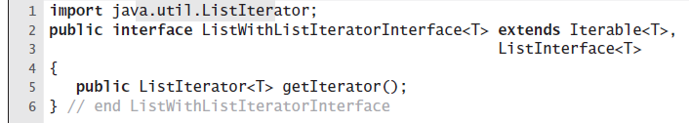
Array-Based Implementation of the Interface ListIterator

Slide 35
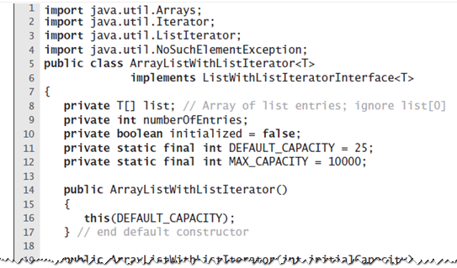
Array-Based Implementation of the Interface ListIterator
class ArrayListWithListIterator

Slide 36
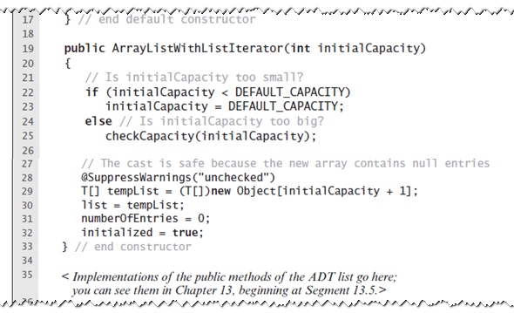
Array-Based Implementation of the Interface ListIterator
class ArrayListWithListIterator

Slide 37
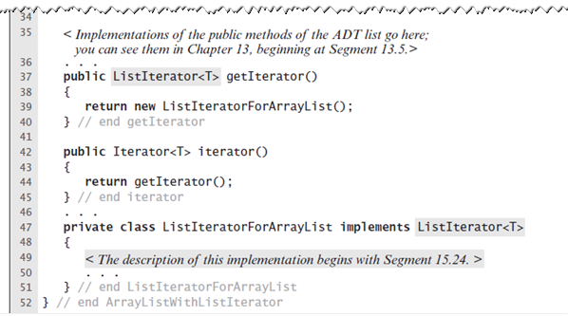
Array-Based Implementation of the Interface ListIterator
class ArrayListWithListIterator

Slide 38
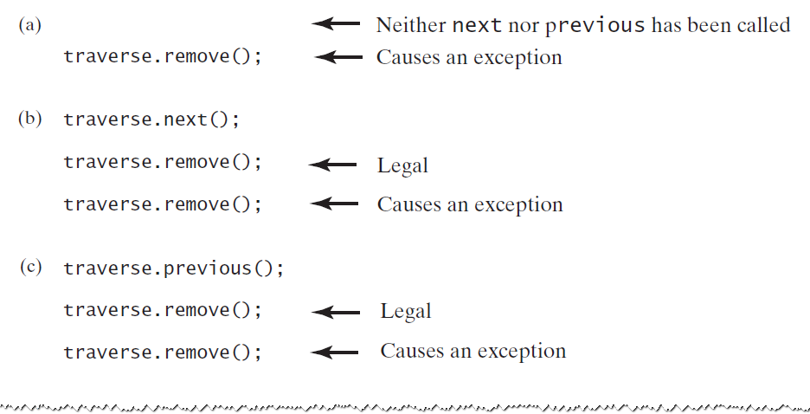
The Inner Class
FIGURE 15-5 Possible contexts in which the method remove of the iterator traverse throws an exception when called

Slide 39
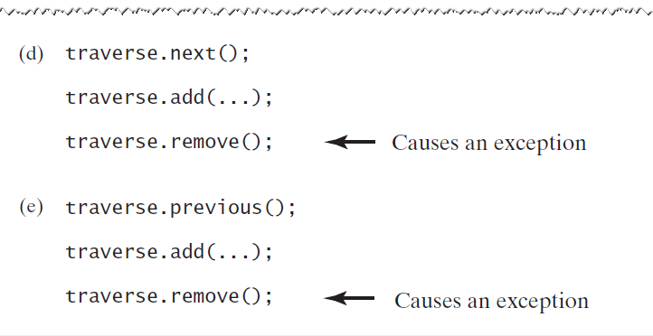
The Inner Class
FIGURE 15-5 Possible contexts in which the method remove of the iterator traverse throws an exception when called

Slide 40
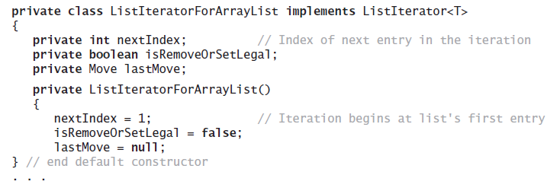
The Inner Class
For inner class, add isRemoveOrSetLegal
Initialized to false by constructor
Set to true by next/pervious
If field is false, remove/set will throw IllegalStateException
methods add/remove will set it to false
remove/set must know which of next/pervious was called so that they can access the correct list entry
Define an enum Move to keep track of this
private enum Move {NEXT, PREVIOUS};

Slide 41
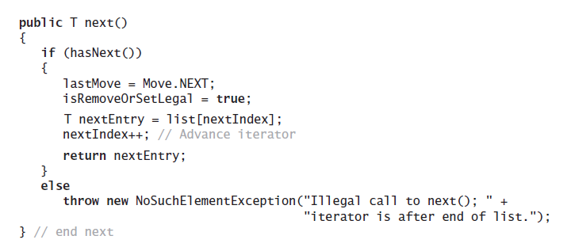
The Inner Class
Method hasNext.
=
Method next.

Slide 42
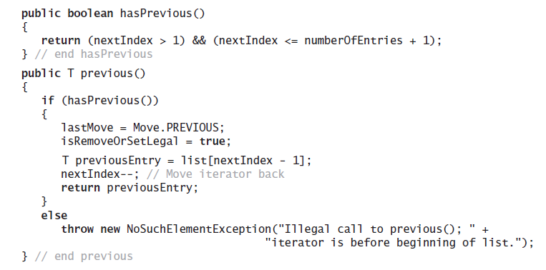
The Inner Class
Methods hasPrevious and previous.

Slide 43
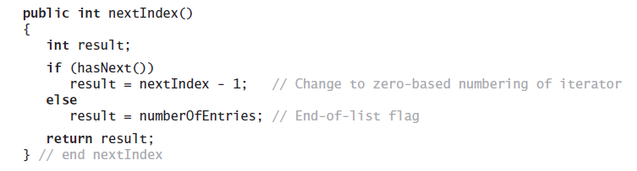
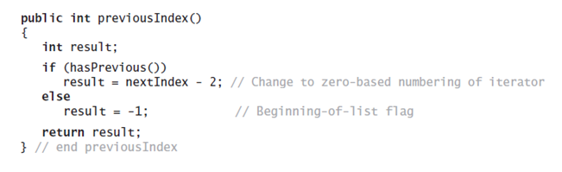
The Inner Class
Methods nextIndex and previousIndex

Slide 44
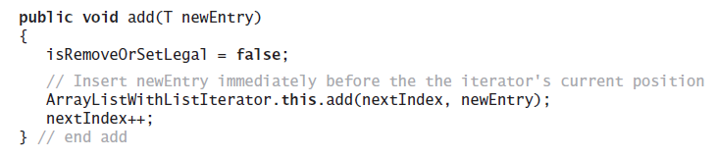
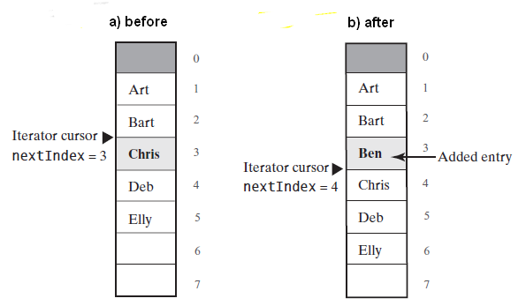
The Inner Class
The method add.

Slide 45
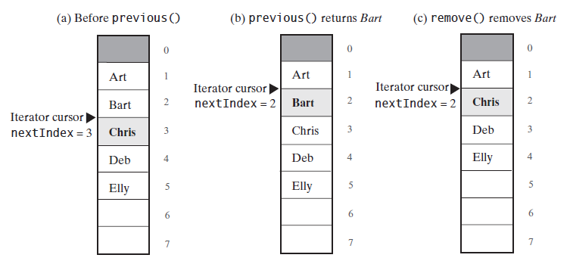
The Inner Class
FIGURE 15-7 The array of list entries and nextIndex (a) just before the call to previous; (b) just after the call to previous but before the call to remove; (c) after the call to remove

Slide 46
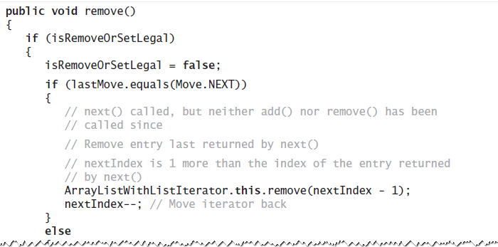
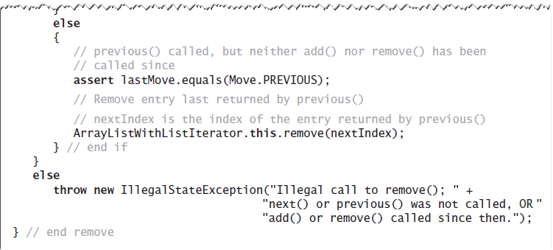
The Inner Class
An implementation of remove.

Slide 47
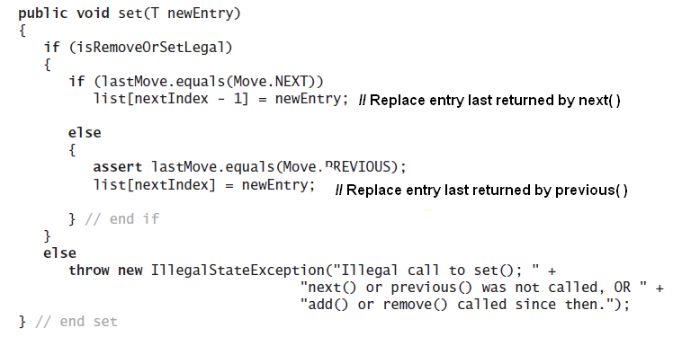
The Inner Class
An implementation of method set.

